Slide 1

Adam Ribblett
Apoorv Gaur
Junpeng Qiu
Leigh Nelson
Biomedical Nanotechnology
Section 008
Team 24
Exit
Biomedical Engineering combines engineering and medicine to create advancements like regenerative tissue growth or build tools to help fight cancer.
Citations
Start
Overview
Notes:
Our peers will interact with this interface by being able to click on the buttons: Exit, Citations, Start, and Overview.
This is our Title Slide it shows: Our Title, Section #, Team #, our Names, an image, and 4 buttons initializing either citations, the program, our overview, or our “exit” script.
This GUI will be developed by Adam Ribblett.

Slide 2
Overview
click one of the following topic you are interested in:
1. Scale & Size – Define One Nanometer
2. Scale & Size – Zoom-in to Nano-sized Particles
3. Nanotechnology in Biomedical Engineering - Introduction
4. Nanotechnology in Biomedical Engineering - “Beginners Scaffolding”
5. Nanotechnology in Biomedical Engineering - Regenerative Tissues
6. Nanotechnology in Biomedical Engineering – Cancer Research
7. Cancer Research - Nanotechnology Approach
8. Cancer Research - Application of Nano-Technology Approach
Home
Notes:
This is a table of contents with buttons shown topics to navigate users to the theme they want to read about. Clicking on the theme will take them to that specific theme GUI. For example if the user clicks on theme 1 it will take them to slide 4 “Scale & Size – Define One Nanometer.” This GUI has a modified navigation bar allowing the user to go back to the home screen.
This GUI will be developed by Junpeng Qiu.

Slide 3
Citations
Page 1 of 1
Cook Biotech, Inc. (2012). Cook Biotech | Technology. Cook Biotech. Retrieved March 28, 2013, from http://www.cookbiotech.com/technology.php
Google maps. (n.d.). Retrieved from https://maps.google.com/
Irini, H. (n.d.). Biomedical Engineering. Howard County Public School System. Retrieved March 28, 2013, from http://web.hcpss.org/~paul_wiedorn/types/biomedicalengineeringih.htm
Layton, J. (n.d.). Can humans regrow fingers?. Retrieved from
http://science.howstuffworks.com/life/human-biology/extracellular-matrix.htm
Regenerative medicine. (2008).
Research overview. (n.d.). Retrieved from http://chem.rutgers.edu/~kbleeweb/research-overview/
Ribblett, A. B. (2013). Waiting Patient [JPEG].
Scott Hollister; NanoBio Node (2013), "[Illinois]: BioEngineering Seminar Series: Modular Engineering of Tissue Reconstruction Scaffolds," Retrieved from https://nanohub.org/resources/16707
Size and scale. (n.d.). Retrieved from
http://education.mrsec.wisc.edu/nanoscale/index.html
Stauffer, N. W. (2013, January 23). Capturing energy from the sun. Retrieved from
http://web.mit.edu/newsoffice/2013/capturing-energy-from-the-sun.html
Valerie m. weaver, ph.d.. (n.d.). Retrieved from http://weaverlab.surgery.ucsf.edu/people/principal-investigators/full-bios/valerie- m-weaver,-phd.aspx
Home
Notes:
This is our Citations GUI. It is filled out in APA format with our current citations used for the construction of this document. The navigation bar at the bottom is the same modified version of the navigation bar on the Overview slide, it will allow the user to return to the Home screen.
This GUI will be designed by Adam Ribblett and Leigh Nelson.

Slide 4
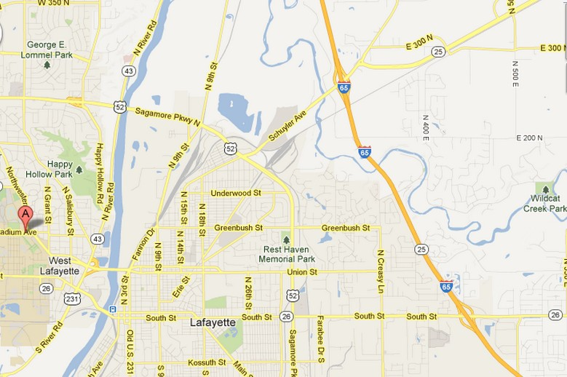
Scale & Size
Define One Nanometer
Find the 1 nm³ square
By definition, 1 nanometer(nm) is equivalent to 10⁻⁹ times 1 meter (m). When using this program, please block in mind that 1nm is even smaller than 1 mm (10⁻³m) and 1 um (10⁻⁶m).
The content below is for you to see how big/small a kilo-meter, meter, millimeter and nanometer is .
Choose Distance:
1 km (1000 m) is the distance from Purdue Armstrong Hall to Wildcat Creek Park.
Armstrong Hall
Creek Park
<<
Home
Overview
>>
Notes:
The pop-up menus is provided to let the users to choose the distance they want see how big/small it is;
The options in the pop-up menus include “1 km, 1 m, 1 mm, 1 um, and 1 nm”;
The picture shows the object of the size the users choose;
The text right of the picture gives a more detailed description of the picture.
The legend below the descripting text will be invisible if the user does not select “1 km”
This GUI will be developed by Junpeng Qiu.

Slide 5
Scale & Size
Zoom-in to Nano-sized Particles
In a 1-nanometer line, there can be arranged 10 atoms of
(A Hydrogen atom has diameter of 1 Armstrong meters, which is 0.1 nm)
1 nanometer
Hydrogen atoms
** The diameter of a single atom always ranges from 0.1 to 0.3 nm
<<
Home
Overview
>>
Notes:
This slide provides users with options to select types of atoms in the pop-up menus;
The options of the pop-up menu will have “hydrogen, helium, sodium, nitrogen, sulfur, oxygen” for the users to select;
The second line of text will change with accordance of the atom the user selects to tell the diameter of the that type of atom;
The picture part depicts how a set of the selected atoms arrange in a 1-nanometer line;
The arrow label will change according to the atoms chosen.
This GUI will be developed by Junpeng Qiu.

Slide 6
Nanotechnology in Biomedical Engineering - Introduction
And now a quick tour into the study of tissue regeneration and its connection to Nanotechnology. For starters, the term ‘regenerative medicine’ refers to the ‘process of regeneration or replacing human cells, tissues or organs to restore or establish normal function’ (Regenerative Medicine).
See if you can guess who first coined the phrase ‘regenerative medicine’ and when they said it.
As you can imagine, the repair and rebuilding of human cells cannot be done by the human eye. Rather, advanced Nanotechnology mapping and design of tiny 3D structures, called scaffolds, must be used to successfully encourage existing skin to interact with the artificial structures and begin to grow back and heal itself.
Dropdown box1 (Person)
Dropdown box2 (Date)
Textbox 1 (And your person is …)
Textbox 2 (And your year is …)
<<
Home
Overview
>>
Notes:
This slide contains a title, body of text with two interactive scroll down buttons, and directional arrows or texts which allow the user to cycle forward or backward, go to the home page, or to the table of contents page. The text above largely introduces to the user of the GUI to the basic subject of tissue regeneration, a biological study that focuses heavily on “self-assembly” as a big engineering idea that requires Nanotechnology to complete, as the size and scale of the scaffolds and structures used to recreate tissues can only be seen and created on the nanoscale level. Dropdown box 1 will contain three names (William Haseltine, Dr. Stephen Badylek, and Valerie M. Weaver, Ph.D.) for the user to select, giving error messages with job descriptions (Regeneration researcher for the University of Pittsburgh, for each person they would select. Dropdown box2 contains three years for the user to pick from (1987,1992, and 1856), with error messages such as “Almost,” “Not even close!”, and “Correct!” being displayed in textboxes 1 and 2 respectively.
This GUI will be developed by Leigh Nelson.

Slide 7
Nanotechnology in Biomedical Engineering - “Beginners Scaffolding”
Scaffolds, three-dimensional structures capable of supporting 3D tissue formations, must carry out many functions. See if you can match the four job titles for scaffolds (on the right) with their descriptions (on the left) by entering the number of the correct job description into the text box directly to the right of the job titles. You may click on the numbered boxes for more information about each job description.
Form
Enter # Here
Pushbox Text
(Pushbox) 1
Fixation
Enter # Here
(Pushbox) 2
Function
Enter # Here
(Pushbox) 3
Formation
Enter # Here
(Pushbox) 4
<<
Home
Overview
>>
Notes:
This slide goes into much more depth about what scaffolding must do in relation to successfully helping tissue regenerate at the nanoscale level. The slide contains a title box, a program description box, five static text boxes (Form, Fixation, Function, Formation, and Pushbox Text), four text boxes, and four push button boxes, as well as the directional arrows or texts which allow the user to cycle forward or backward, go to the home page, or to the table of contents page. As the program description box describes, the user will be able to click on each pushbox to view the information inside, which will appear in the “Pushbox Text” text box. If the user incorrectly enters the wrong number into the wrong job title box, an error message will prompt them to try another answer. If the user enters the right number into the respective job title box, a “You’re correct!” message will appear. As for what will be in the pushboxes, here are the following definitions of the job title boxes: Pushbox 1 = Must be securely fixed to surrounding tissue” (Goes with Fixation static text box; Pushbox 2 = Must enhance and control tissue formation” (Goes with Formation static text box); Pushbox 3 = Must fill complex 3D defects (Goes with Form static text box); Pushbox 4 = Must bear defect specific load forces at first, and then be able to help tissue grow (Goes with Function static text box). Finally, once the user has successfully completed the interactive activity, one last message will appear in the Pushbox Text text box: “Remember, scaffolds must be built and designed to be able to successfully meet all four job titles of Form, Fixation, Function and Formation if the tissues in your body are to grow back successfully. The size and scale of Nanotechnology allows researchers to build detailed scaffolding that molds itself into the body tissues so as to coax the body into “regenerating” its lost particles.
This GUI will be developed by Leigh Nelson.

Slide 8
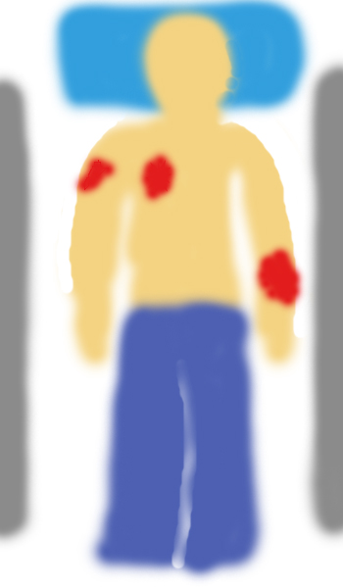
Nanotechnology in Biomedical Engineering - Regenerative Tissues
Hello Doctor!
Welcome to the extracellular matrix (ECM) training simulation.
The patient is waiting. Good luck.
Begin Simulation
<<
Home
Overview
>>
Notes:
This GUI is a simulation that requires the user to interact with the image in the left box of the main screen of the GUI. The “Begin Simulation” button will disappear and the text box “hello doctor” will take its space allowing it to issue more commands to the user to help the patient heal by using ECM technology. It will also give hints towards what to do and how to do it (Such as look and select a wound to address, wounds are shown by the blood on the image). If the user needs to interact with something outside of the image, it will appear. This technology is based off of the COOK BIOTECH INC. technology that is derived from pig intestines that act as a scaffold to allow for faster healing and the body naturally consumes it. This is based off of the idea of self-assembly, a big nano-science idea of Nanotechnology. Because the body will self-assemble inside the scaffold applied to the wound. As Regenerative Tissue Growth is an important part of Biomedical Engineering this helps the user learn about both Biomedical Engineering and Self Assembly. The Error Checking will not allow the user to abuse things inside the simulation, such as limiting them to a defined path through the Simulation such as starting at the left arm first and working right. They will be able to use the navigation bar at the bottom of the screen, so if they go forwards or backwards the GUI will save the position they are in the simulation allowing them to return where they left off.
The simulation itself begins when the user clicks the “Begin Simulation” button and then continues to allow the user (“doctor”) to apply the COOK BIOTECH INC. technology to the wounds of the patient showing the benefits of the technology and how it works. The simulation is over once the full process is shown, after the patient has fully recovered from his wounds. The simulation will also explain what the technology ECM is and how it works, and how the COOK BIOTECH INC. technology works as found on their website (“http://www.cookbiotech.com/technology.php”)
This GUI will be developed by Adam Ribblett.

Slide 9
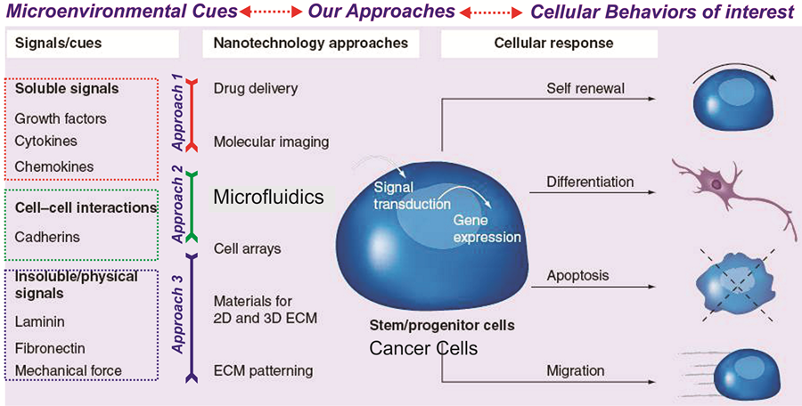
Nanotechnology in Biomedical Engineering – Cancer Research
Find the 1 nm³ square
<<…
Home
Table of Contents
…>>
Notes:
This picture depicts how Nanotechnology approaches help in researching cancer cellular responses to different signals. Each type of approach can be learnt about in detail by just clicking on them, and the GUI will take you to the next slide, which will display information on how minutely the cells were monitored (Size and Scale) to form conclusions.
To further depict its use in Biomedical Engineering, you can also click on the different cellular responses and see how Nanotechnology helped to figure their reaction and effects.
Citations: Research overview. (n.d.). Retrieved from http://chem.rutgers.edu/~kbleeweb/research-overview/
This GUI will be developed by Apoorv Gaur.

Slide 10
Cancer Research - Nanotechnology Approach
.
Interactive picture related to the Nano-tech approach
Approach:
Description of Approach:
Link of approach to Bio-Medical Engineering
Link of approach to Size and Scale
<<…
Home
Table of Contents
…>>
Notes:
In this slide, the nanotechnology approach will be chosen from the pop-menu, or from clicking an object at the picture in the last slide. The above details will be displayed in the text boxes, and an interactive flash picture will be accommodated in the image space where the user will be able to physically interact and learn how this specific Nanotechnology approach helps in observing key Biomedical Engineering designs and projects at the Nanoscale level (Size and Scale).
This GUI will be developed by Apoorv Gaur.

Slide 11
Cancer Research - Application of Nano-Technology Approach
.
Interactive Picture related to the cancer cellular response observed due to Nanotechnology
Approach:
Description of Approach:
Description of Cellular response:
How this Nanotechnology approach helped with this research:
<<…
Home
Table of Contents
…>>
Notes:
This third slide will give us more of an insight into application of Nano technological approaches in Biomedical Engineering, specifically observing cancer cellular responses. Once again, the pop-up menu will let us decide which approach we are looking into, and then, it will be displayed how this approached was used to observe a type of cellular response to a substance or material. The space for image above is for cells and their responses to situations as observed by the specific nanotechnological approach (Size and Scale)
This GUI will be developed by Apoorv Gaur.

